Slide 1


Vets 2 tech
authors: Beth Gallatin, connie Rodriguez, john mcdurmon
Organization: Hal and Inge marcus school of engineering | Saint Martin’s University

Slide 2



Meet the team
Beth gallatin
Connie Rodriguez​
john mcdurmon​
Project Manager
Coordination, stakeholder communication
Development
Backend, frontend, AWS integration
Design
UI/UX design, user experience
Notes:
Note whoever has this slide will introduce themselves in a slightly different way when it is decided the sections we are doing
"Our team consists of Beth Gallatin, our Project Manager who ensures coordination and stakeholder communication; Connie Rodriguez, our Lead Developer specializing in backend, AWS integration, and machine learning implementation; and John McDurmon, our UI/UX Designer, responsible for crafting an inclusive and intuitive user experience. Our team is small and so all of these roles do overlap so each team member contributes to all areas of the project"

Slide 3

purpose
problem:
Veteran’s face challenges in transitioning to tech careers
Accelerated programs require tailored support and resources.
Goals:
Provide guided learning paths and interactive study tools
Enhance engagement through machine learning and AI-powered support
Deliver predictive insights to improve outcomes
Notes:
"The purpose behind our project is to address a twofold problem: veterans face challenges transitioning to tech careers, and the accelerated nature of this program demands highly customized support tools. Our platform will provide guided learning paths, machine learning-powered quizzes for tailored learning, and predictive insights using data analysis for stakeholders. It will also provide study material, a ‘study buddy’ AI chatbot feature, along with assistance for current and graduated students such as certification preparation material and practice exams. These features make this project highly complex and impactful."

Slide 4

stakeholders
Client details:
Objective:
Create a web platform that guides students to the best-fit program
Provide real-time AI-powered support using a ‘study buddy’
Leverage Data Analytics for actionable insights to stakeholders
Ensure Scalability, Usability, and Security
Accelerated 16-week program for military personnel veterans and military families
Professional development education and training in Computer Science and Information Technology
Provides three learning pathways:
Server Cloud Application (SCA)
Cloud Application Development (CAD)
Cybersecurity Administration (Cyber)
Notes:
"Hello and thank you for joining us. Today, we are presenting our Washington Vets2Tech project, a partnership between Saint Martin’s University Vets2Tech program and our team. This program provides accelerated pathways to tech careers for veterans and their families, with three key learning tracks: Server Cloud Application, Cloud Application Development, and Cybersecurity Administration."
"Our objective is ambitious. We are creating a student platform to guide students to their best-fit program, supported by an AI-powered chatbot and adaptive learning features. The platform is designed to address the unique needs of veterans transitioning into tech careers, offering tailored resources to ensure their success. It will also offer continued support to current and graduated students."

Slide 5
Project constraints
Technical constraints
Qualitative Constraints
AI Integration Complexity
Scalability vs. Budget Constraints
Data Privacy and Security Compliance
Adaptive Testing Model Development
User-centric Design
Cross-platform Compatibility
Stakeholder Feedback Integration
Ethical Considerations
Notes:
"Moving on to the constraints of the project, the technical complexity of this project stems from multiple factors. First, the machine learning aspect, which includes training a chatbot capable of dynamic, context-aware responses, and developing an adaptive testing model for quizzes that adjusts based on user performance. Second, scalability and budget constraints, as this platform must serve diverse user needs while remaining cost-effective. And as always data privacy and security compliance are of the utmost importance.”
"From a qualitative perspective, we prioritize user-centric design and cross-platform compatibility while ensuring data privacy and ethical considerations are at the forefront. While these are only a few of the constraints covered here today, there is a thorough list of all the constraints in our SRS document for your review.”

Slide 6
Engineering and computing principles
Modular and Scalable Architecture:
Problem Solved: AI Integration Complexity and Scalability vs. Budget Constraints
Interface Segregation Principle:
Problem Solved: Overloaded Interfaces and Complexity in Code Maintenance
Loose Coupling and High Cohesion:
Problem Solved: Tight Dependencies and Difficult Maintenance
Agile Development and Iterative Feedback Integration:
Problem Solved: Stakeholder Feedback Integration and User-Centric Design
Security by Design:
Problem Solved: Data Privacy, Unauthorized Access, and Compliance
Robustness:
Problem Solved: Handling Unexpected User Inputs, System Failures, and ensuring performance optimization.
Notes:
"To manage this complexity previously mentioned, we adhere to principles such as modular architecture, ensuring the platform can scale and evolve efficiently. Using loose coupling to reduce dependencies, thereby simplifying maintenance. For the adaptive quiz system, we use iterative development to test and refine the machine learning algorithms in real-world scenarios, ensuring both accuracy and fairness. Additional principles used are available in the SRS document diving into more detail."

Slide 7
Design Exploration and Alternatives
Hosting platform
Quiz system design
Ai powered
AWS
AZURE
Google Cloud Platform
Custom Development
Learning Management System
Open-source Quiz Libraries
ML-powered AI
Basic Rule-based AI
Data analytics
Adaptive learning
User experience
R
Python
Tableau
AI Driven Adaptive Learning
Static Quiz Questions
Inclusive and Intuitive UX
Minimal UX
Notes:
"We conducted extensive research into various systems, platforms, software programs, programming languages, and artificial intelligence technologies to identify the most suitable tools for our objectives. This analysis included evaluating their scalability, efficiency, and integration capabilities. Based on this research, we chose solutions such as AWS for hosting, R for data analysis, and custom development to address the specific requirements of the project. Our design decisions reflect the project’s technical demands. AWS was selected for hosting due to its scalability and support for machine learning services. The AI components leverage machine learning for the chatbot and quizzes, using supervised learning algorithms trained on diverse datasets. We also focus on delivering an intuitive UX, balancing complexity with accessibility.”

Slide 8
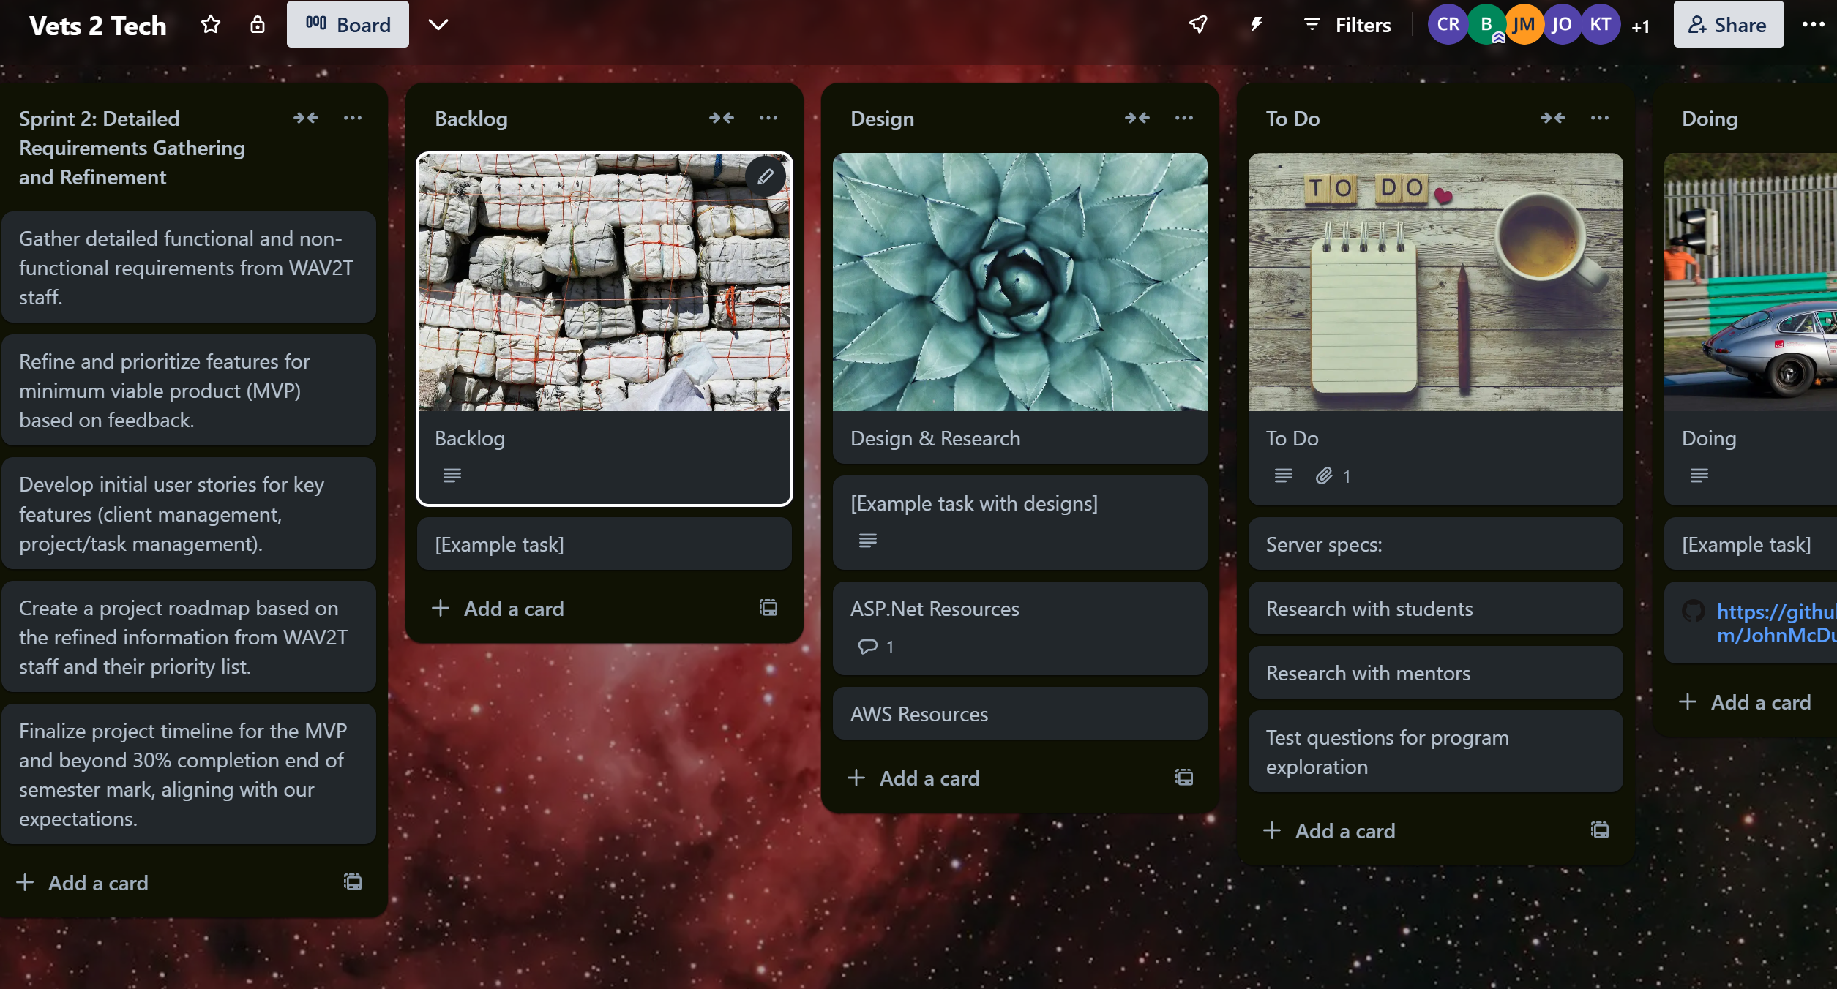
PLANNING WITH TRELLO
Notes:
"Here, we’d like to share an overview of our Trello board, which we used to manage our project sprints and track progress effectively. As you can see, the board is organized into several columns representing different stages of our workflow. These include 'Backlog,' 'To Do,' 'In Progress,' 'Testing,' and 'Completed', and with weekly sprint information. Each task is represented as a card, and we prioritized these tasks based on our sprint goals. This approach ensured a clear focus for every sprint and allowed us to maintain steady progress. In the planning phase, we identified key deliverables and broke them into manageable tasks. Each card includes detailed descriptions, due dates, and assignees to ensure accountability. We also utilized labels and checklists within the cards to track subtasks and ensure alignment with our project timeline. This Trello board was instrumental in facilitating collaboration and providing a transparent view of our progress."

Slide 9
ACM/ferpa/IEEE/ADA Codes, Guidelines, and regulations
ACM
FERPA
IEEE
ADA
Association for computing machinery
Family education rights and privacy act
American's with disabilities act
Institute of electrical and electronics engineers
Fairness
Transparency
Privacy
Integrity
Data Protection
Consent
Confidentiality
Student Rights
Reliability
Safety
Professionalism
Quality
Accessiblity
Inclusivity
Usability
Compliance
Notes:
"Our project is built with a clear understanding of the regulatory, ethical, and technical standards that must be met. Adhering to ACM, FERPA, IEEE, and ADA guidelines ensures that our platform is fair, transparent, accessible, and secure. We also recognize the risks associated with these standards and have proactively implemented strategies to mitigate them. For example, FERPA compliance is critical for protecting student data. To address this, we will integrate encryption methods and secure authentication protocols to prevent data breaches. Algorithm bias presents another significant risk, especially as our project involves features like personalized exams or AI-driven tools. To tackle this, we are testing our algorithms with diverse datasets to ensure fairness and reduce bias. Accessibility is equally important. We will follow ADA guidelines by designing with inclusivity in mind—conducting usability tests with assistive technologies like screen readers and ensuring our interface meets WCAG standards. Finally, we will conduct regular audits of our platform to ensure that ethical principles and transparency remain at the forefront of our development process. These measures help us minimize risks and ensure the platform upholds the highest standards in all aspects of design and functionality.”

Slide 10
Risks: artificial intelligence
Risks found
mitigation
Content Overlap or Redundancy
Training Data Quality
Integration Complexity
Real-Time Response Challenge
Security
Dynamic Content Creation
Regularly Updating Training Data
Using Modular Design for Isolation
Implementing Load Balancing
Access Control, Tracking and Monitoring
Notes:
"With any project of this scale, risks are inevitable. For AI, training the chatbot presents challenges in ensuring high-quality, non-redundant training data and maintaining real-time response reliability. Additionally, there’s a risk of the chatbot misunderstanding user input, leading to inaccurate responses. To mitigate these risks, we’ve implemented modular design, regular data updates, load balancing, and ongoing fine-tuning of natural language processing (NLP) models to improve the chatbot’s comprehension and adaptability."

Slide 11
Risks: machine learning
Risks found
mitigation
Algorithm Bias
Model Accuracy
Overfitting
Security of Machine Learning
Using Diverse training datasets and regular bias audits
Appliied supervised learning algorithms with extensive validation
Using cross-validation and regularization
Employ adversarial training to make model resilient against malicious input
Notes:
"For machine learning, algorithm bias and overfitting pose significant risks. Furthermore, insufficient generalization of the model can lead to poor performance on unseen data. These risks are addressed through diverse training datasets, rigorous validation, adversarial training to make the model resilient against malicious input, and the use of dropout and regularization techniques to prevent overfitting during training."

Slide 12
Risks: data analysis
Risks found
mitigation
Data Breach/Data Loss
System Security Vulnerablities
Misinterpretation of Data
Algorithmic Errors
Implementing strong encryption protocols, secure data access control, regular security audits, and penetration testing
Enforcing secure user authentication and maintain transparency and data usage
Employing data validation checks
Executing testing and validation of all data
Notes:
"In data analysis, risks include breaches, misinterpretation of results, and incomplete datasets leading to inaccurate conclusions. To address these, we enforce encryption, secure authentication, and data validation protocols. Additionally, we propose comprehensive data cleaning processes and the use of visual analytics to better communicate insights and reduce the likelihood of misinterpretation."

Slide 13
Risks: general
Risks found
mitigation
User Adoption and Engagement
Cross-Platform Compability
Unforseen Budget Overruns
Proprietary Content
Long-Term Maintenance Challenges
Operator Error in System Managment
Conducted user engagement campaign
Applying responsive design principles
Implementing real-time budget tracking
Subject matter expert (SME’s) used for intellectual property and content development
Thoroughly documenting of all coding processes
Recursive comprehensive training, having Standard Operating Procedures (SOP’s) and role based access controls.
Notes:
“This slide highlights general key risks we have identified during the planning phase of our project, along with proposed mitigation strategies to address them. User Adoption and Engagement is a critical factor for the success of our platform. To address this risk, we conducted a user engagement campaign, focusing on understanding user needs and preferences, ensuring that the platform design and features align with their expectations. Cross-platform compatibility is another potential challenge, as users will access the platform on a variety of devices. To mitigate this, we plan to apply responsive design principles, ensuring the platform is functional and visually appealing on desktops, tablets, and smartphones. Unforeseen Budget Overruns are always a concern in project development. We aim to minimize this risk by implementing real-time budget tracking tools and conducting frequent reviews to align expenditures with forecasts. For Proprietary Content, we recognize the need to ensure high-quality and compliant intellectual property development. We plan to engage subject matter experts (SMEs) to develop proprietary content and ensure it meets both legal and functional requirements. Long-Term Maintenance Challenges can arise if proper documentation is not maintained. To prevent this, we are thoroughly documenting all coding processes, making future updates or troubleshooting more efficient and sustainable. Finally, Operator Error in System Management could pose significant risks. To address this, we propose creating comprehensive training programs for system administrators, developing Standard Operating Procedures (SOPs), and implementing role-based access controls to limit system modifications to authorized personnel. These strategies are integral to our planning and will ensure that risks are proactively addressed as the project moves into the development phase."

Slide 14
action plan
Sep
Oct
Nov
Dec
2024
Team Onboarding
Defined project scope and objectives
Gathered requirements and stakeholder input
Researched platform architecture and technology stack
Bi-weekly client meetings
Finalized platform architecture and technology stack
Researched AWS infrastructure setup and configuration
Planned developmental sprints and created sprint roadmap utilizing Trello
Initialized version control with GitHub
Setup development environment
Completed sections 1-3 of the SRS document
Create initial UI mock-ups
Conducted market research and SME interviews
Initiated question bank development
Presentation to the EAB board
Develop user authentication and registration
Notes:
" As you can see, beginning in September, we defined the project scope, gathered requirements, and researched platform architecture. Throughout the semester we have done countless hours of research and planning to ensure that we are able to create a product that fits the exact needs of our client and their users. We have set up our development environment, and initialized version control in GitHub. Now we are presenting our findings to you with the hopes of full deployment of our extensive platform by April."

Slide 15
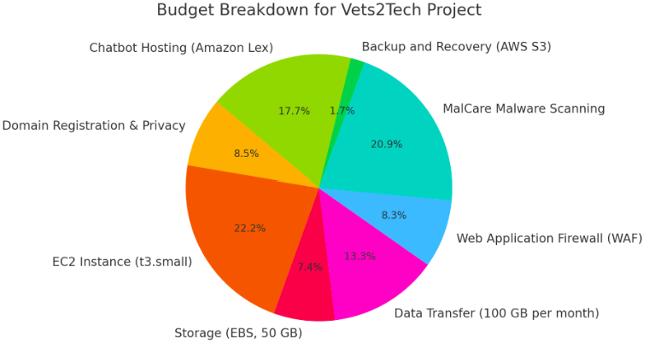
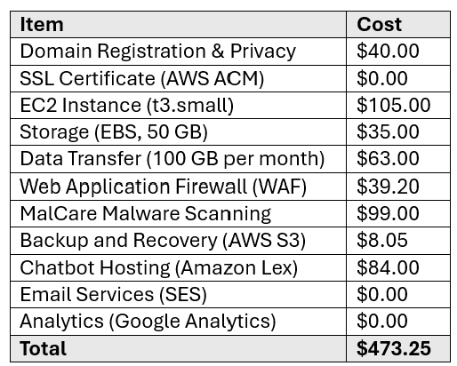
Budget
Notes:
"The complexity of the project greatly impacts our budget, which is carefully allocated across AWS infrastructure, machine learning model development, and secure data handling. The pie chart highlights the distribution of resources, ensuring critical components like AI and security are adequately funded. In order to maximize our budget we also found tools and resources that had no monetary effect on the budget, as you can see listed in the chart. This allowed us to use funds for more important and complicated areas of the project such as AI integration."

Slide 16
Next steps
Jan
Feb
Mar
Apr
2025
Complete core backend coding
Finalize the integration of chatbot functionality
Set up cloud infrastructure
Begin API testing for backend services
Develop initial adaptive testing model and training data
Implement core security features
Conduct initial testing of machine learning model
Finalize data privacy measures to comply with FERPA
Design frontend interface
Integrate the frontend and backend services and machine learning components
Begin user testing gather feedback
Refine the user interface based on feedback
Conduct full system testing, including functional, performance, and security tests.
Address any bugs or issues identified during testing
Set up CI/CD pipeline for automated testing and deployment
Prepare the platform for launch, including final client review and deployment on AWS
Notes:
" Looking ahead, we have outlined the next critical steps to ensure the successful completion of our project. Our immediate focus will be on completing backend development, which involves creating database structures, optimizing server-side functionality, and ensuring the system’s overall scalability. This will lay the foundation for seamless user interactions and data management. Next, we will integrate the chatbot functionality into the platform. This involves training the chatbot on diverse, high-quality datasets to improve its accuracy and responsiveness. We will also incorporate user feedback mechanisms to refine its ability to handle a wide range of queries effectively. Simultaneously, we will refine the adaptive testing model to ensure it provides accurate and fair assessments tailored to individual users. This includes rigorous testing of the algorithm’s performance to address concerns like bias, overfitting, and edge cases. By March, the platform will undergo extensive user testing with a diverse group of beta testers, including representatives of the target audience. This phase will help us gather critical feedback on usability, functionality, and overall performance, allowing us to make necessary adjustments before final deployment. Finally, by April, after incorporating feedback and addressing any identified issues, the platform will undergo a final client review. This will ensure that it meets all requirements and expectations. Once approved, the platform will be ready for deployment, marking the culmination of our efforts and the beginning of its use in real-world scenarios."

Slide 17

Thank You
Vets 2 Tech Program
Engineering Advisory Board
Saint Martin’s University
Hal and Inge Marcus School of Engineering
Dr. Dvorak
December 4, 2024
Notes:
"Thank you for your attention and support of this initiative. The complexity of this project demonstrates its significance in transforming lives through education and technology. For more detailed information on the project, and a deeper understanding of the planning and effort that the project demands, we encourage you to review the full SRS document, thank you for your time."

